Slide 1


SIMATS ENGINEERING
SAVEETHA INSTITUTE OF MEDICAL AND TECHNICAL SCIENCES
SMART WATER DISTRIBUTION AND LEAK DETECTION MANAGEMENT SYSTEM USING MULTI AGENT REINFORCEMENT LEARNING
MLA0301-REINFORCEMENT LEARNING
Presented by:
A.JAHNAVI (192472214)
K.KAVYA(192425283)
K.NEEHA(192425245)
Guided by:
DR. G.A.SENTHIL

Slide 2


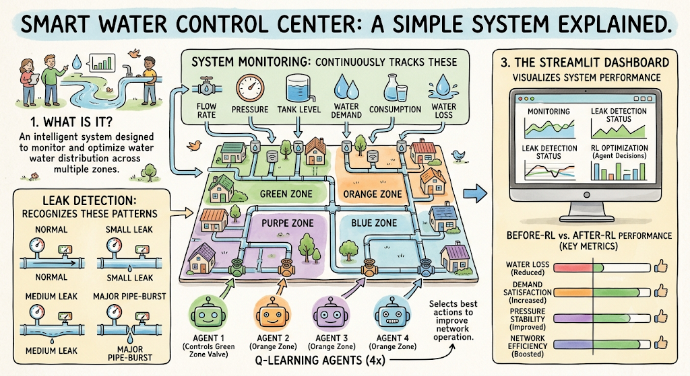
INTRODUCTION
Smart Water Control Center is an intelligent system designed to monitor and optimize water distribution across multiple zones.
It continuously monitors flow rate, pressure, tank level, water demand, consumption, and water loss using simulated sensor data.
The system detects water leaks by identifying abnormal flow and pressure patterns under normal, small leak, medium leak, and major pipe-burst conditions.
Four Q-learning agents independently control the valves of four distribution zones and select suitable valve actions to improve network operation.
A Streamlit dashboard visualizes monitoring, leak detection, RL optimization, and Before-RL vs After-RL performance based on water loss, demand satisfaction, pressure stability, and network efficiency.

Slide 3
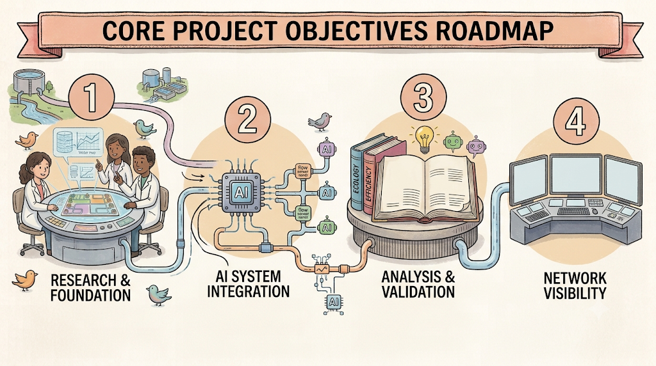
OBJECTIVES
To develop a smart water distribution simulation that monitors flow, pressure, tank level, demand, consumption, and water loss.
To detect and identify different levels of water leakage using abnormal flow and pressure patterns.
To implement four independent Q-learning agents for intelligent control of distribution-zone valves.
To optimize valve operations by maximizing demand satisfaction and pressure stability while minimizing water loss.
To evaluate and visualize network performance before and after RL optimization using a Streamlit-based dashboard and final report.

Slide 4
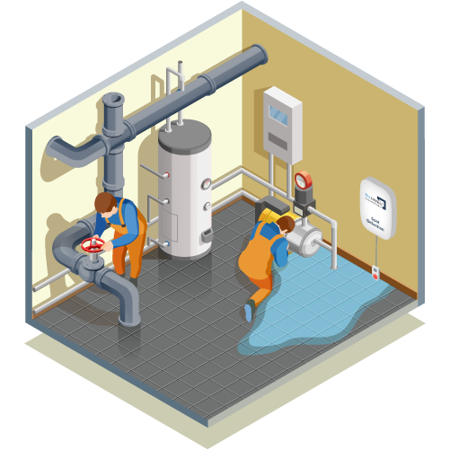
SCOPE OF THE PROJECT
Applicable to urban, rural, and industrial water distribution networks.
Covers a simulated four-zone water distribution network with reservoir, pipelines, and controllable valves.
Provides real-time-style monitoring and visualization of network operating conditions through a Streamlit dashboard.
Supports different leak scenarios and analyzes their impact on water flow and pressure.
Applies multi-agent Q-learning to make valve-control decisions for individual distribution zones.
Evaluates the effectiveness of RL using water loss, demand satisfaction, pressure stability, and network efficiency and generates a final performance report.

Slide 5
LITERATURE REVIEW
S.No | Author & Year | Research Area | Method / Technique | Key Findings
1 | Mounce et al. (2024) | Water Leak Detection | Machine Learning | ML techniques can identify abnormal flow and pressure patterns associated with water leakage.
2 | Romano et al. (2025) | Smart Water Distribution | IoT and Sensor Monitoring | Real-time sensors improve monitoring of water flow,
3 | Adedeji et al. (2024) | Pipeline Fault Detection | AI and Machine Learning | AI-based methods can detect pipeline abnormalities and support predictive maintenance.
4 | Xu et al. (2024) | Water Distribution Optimization | Reinforcement Learning | RL can optimize pump and valve operations while maintaining suitable pressure and reducing energy usage.

Slide 6
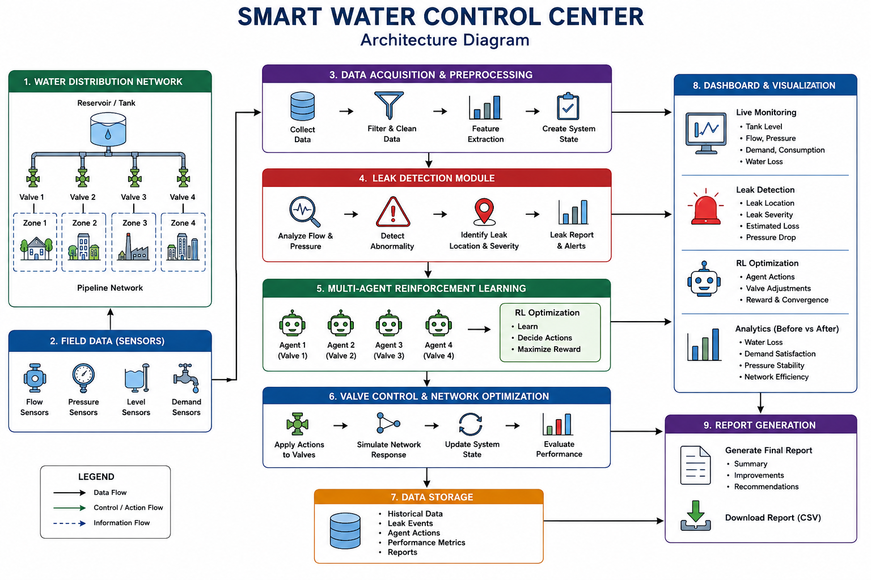
ARCHITECTURE DIAGRAM

Slide 7
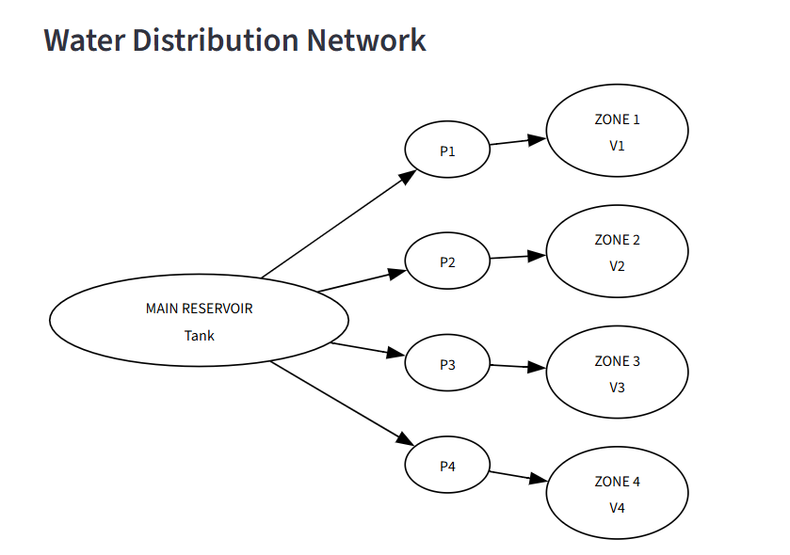
Module 1
Water Distribution Monitoring and Data management
Simulates a four-zone water distribution network consisting of a reservoir, pipelines, and controllable valves.
Collects and manages network parameters such as flow rate, pressure, tank level, water demand, consumption, and water loss.
Generates time-varying operational data to represent changing water demand and network conditions.
Monitors the network continuously to identify normal and abnormal operating conditions.
Provides real-time-style visualization of the collected data through the Streamlit dashboard for further leak detection and RL-based optimization.

Slide 8
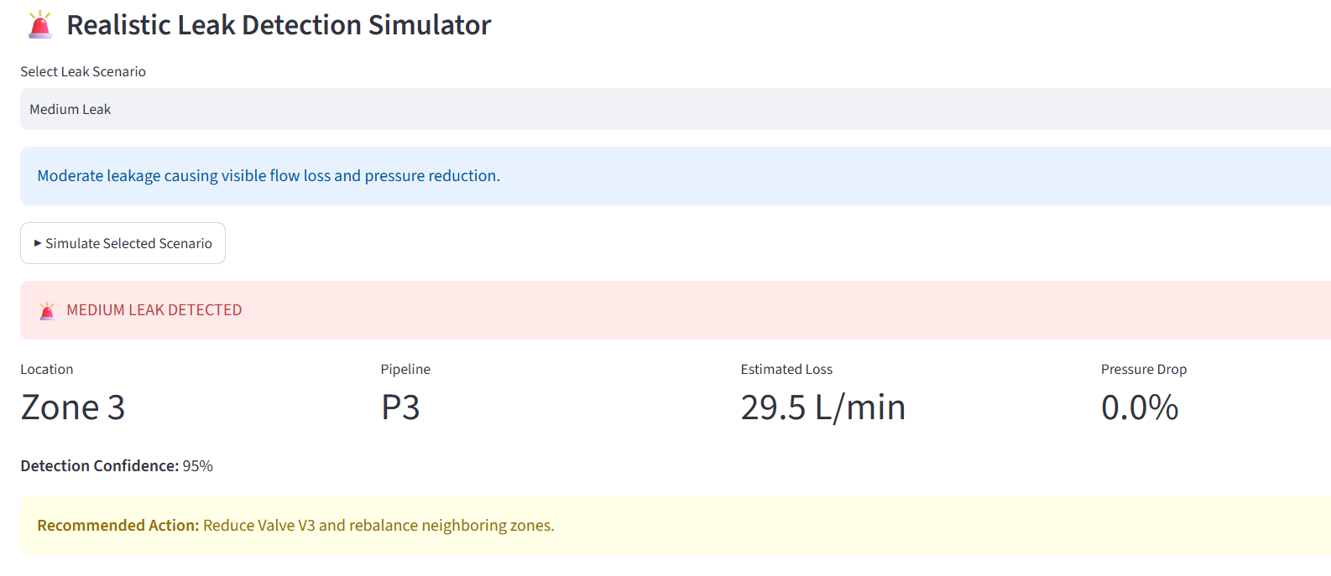
Module 2
Intelligent Leak Detection and Fault Analysis
Simulates different network conditions: Normal Operation, Small Leak, Medium Leak, and Major Pipe Burst.
Analyzes abnormal flow rate and pressure variations to identify leakage.
Estimates the leakage loss and pressure drop for the affected zone.
Determines the leak severity and detection confidence based on the simulated conditions.
Provides a recommended corrective action, such as reducing the affected zone valve and rebalancing water supply.

Slide 9
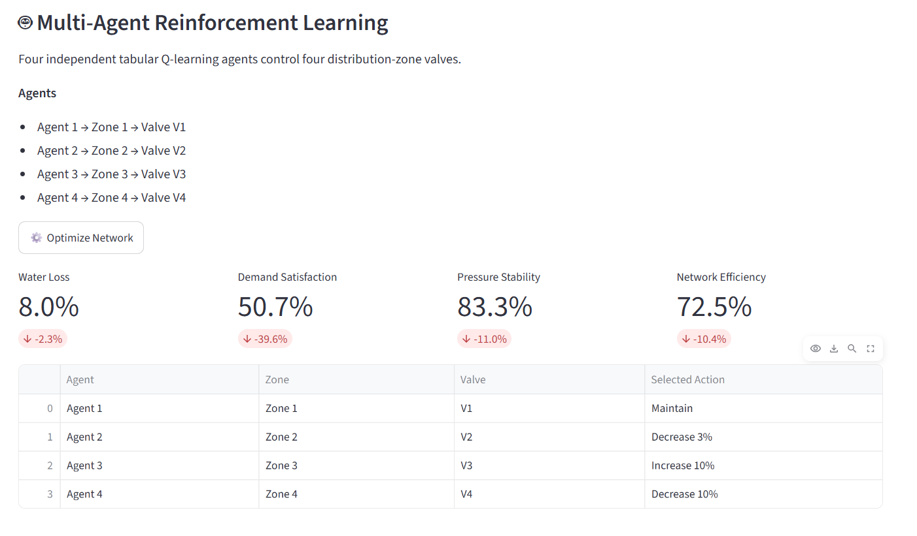
Module 3
Multi-Agent Reinforcement Learning-Based Water
Distribution Optimization
Uses four independent Q-learning agents, with each agent controlling one distribution-zone valve.
Each agent observes network conditions and selects actions such as decrease, maintain, or increase valve opening.
The reward function encourages water-demand satisfaction and pressure stability while penalizing water loss.
Optimizes valve operation to improve overall water distribution and network efficiency.
Compares Before-RL and After-RL performance using water loss, demand satisfaction, pressure stability, and network efficiency.

Slide 10
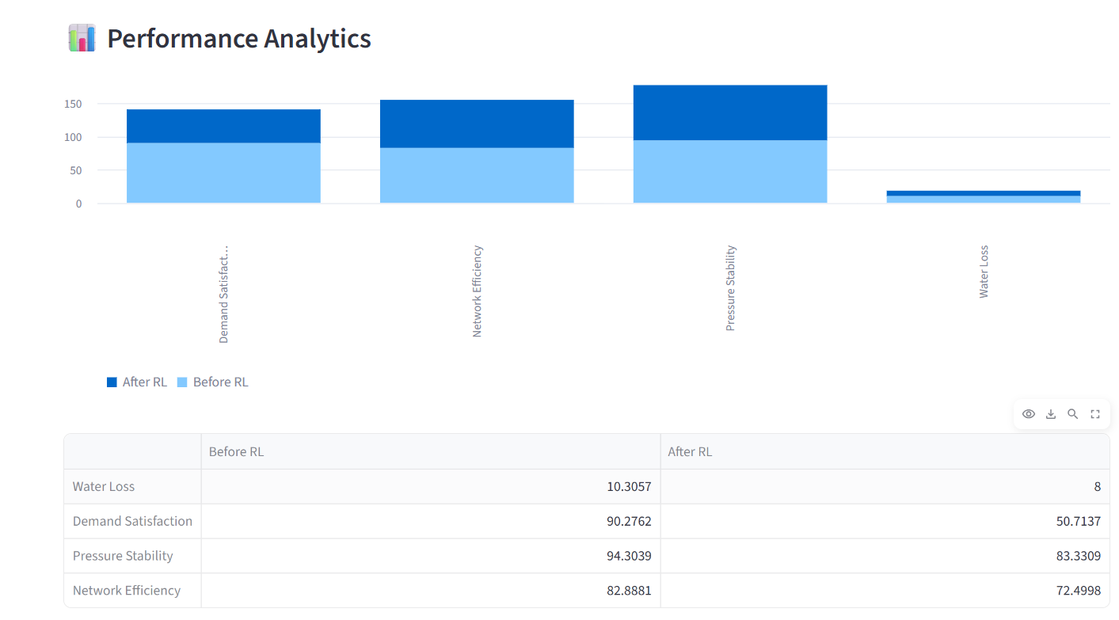
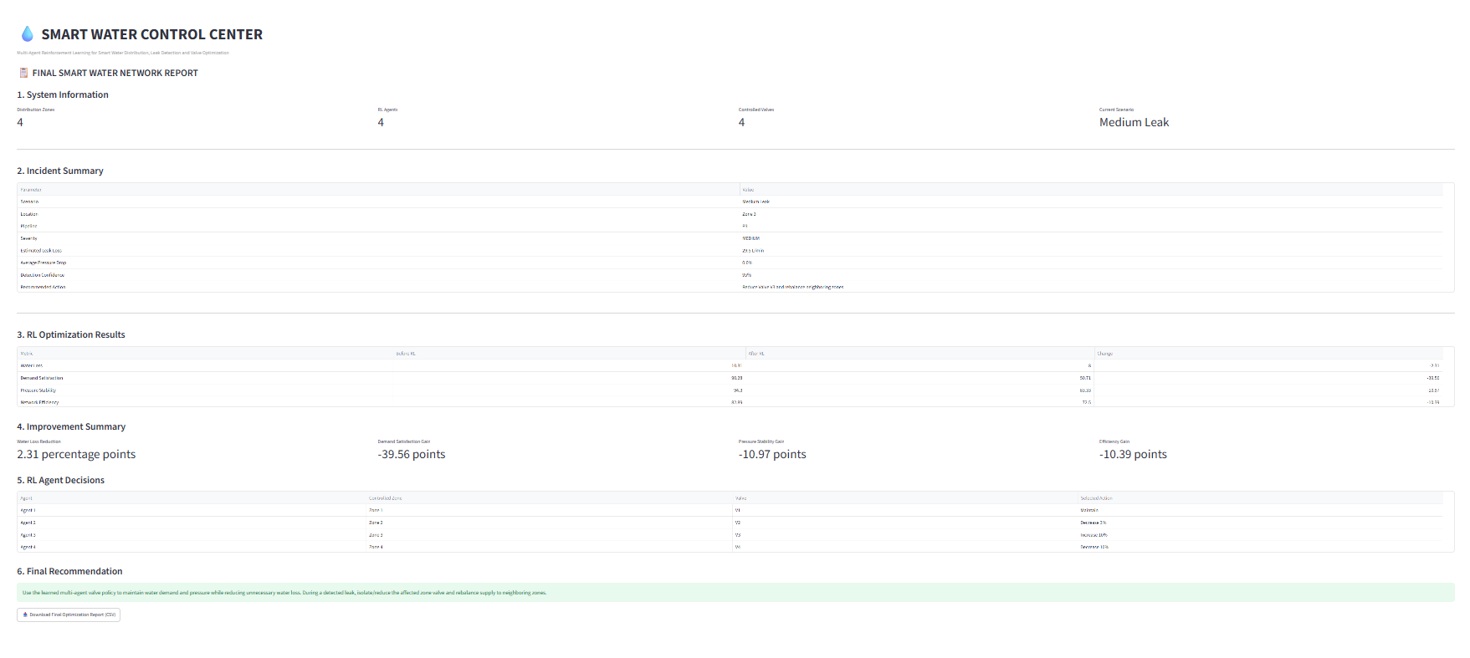
IMPLEMENTATION

Slide 11

RESULT AND DISCUSSION
The developed system successfully provides real-time-style monitoring of flow rate, pressure, tank level, water demand, consumption, and water loss through the Streamlit dashboard.
The leak detection module successfully distinguishes Normal Operation, Small Leak, Medium Leak, and Major Pipe Burst based on changes in flow loss and pressure conditions.
The four Q-learning agents successfully generate valve-control actions for the four distribution zones to improve network operation.
The system evaluates the effect of RL optimization using water loss, demand satisfaction, pressure stability, and network efficiency, allowing clear Before-RL and After-RL comparison.
Overall, the simulation demonstrates that RL-based valve optimization can improve water distribution performance while reducing unnecessary water loss and maintainin

Slide 12
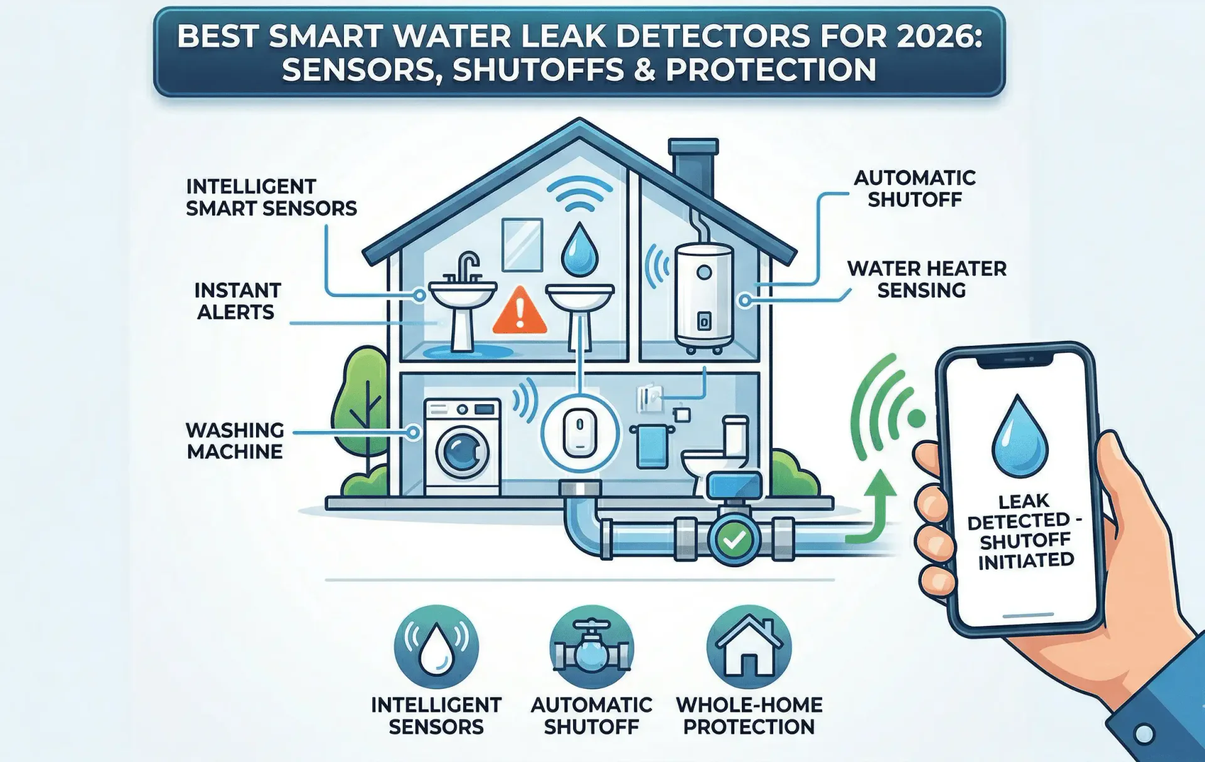
CONCLUSION
The Smart Water Control Center successfully integrates water-network monitoring, leak detection, and reinforcement-learning-based valve optimization into a single Streamlit application.
The system monitors important parameters such as flow, pressure, tank level, demand, consumption, and water loss under changing simulated network conditions.
Different leak scenarios—normal operation, small leak, medium leak, and major pipe burst—produce different flow-loss and pressure-abnormality patterns for fault analysis.
The four Q-learning agents provide zone-level valve-control decisions, with the reward function encouraging demand satisfaction and pressure stability while reducing water loss.
The Before-RL and After-RL comparison provides a measurable evaluation of water loss, demand satisfaction, pressure stability, and network efficiency.

Slide 13
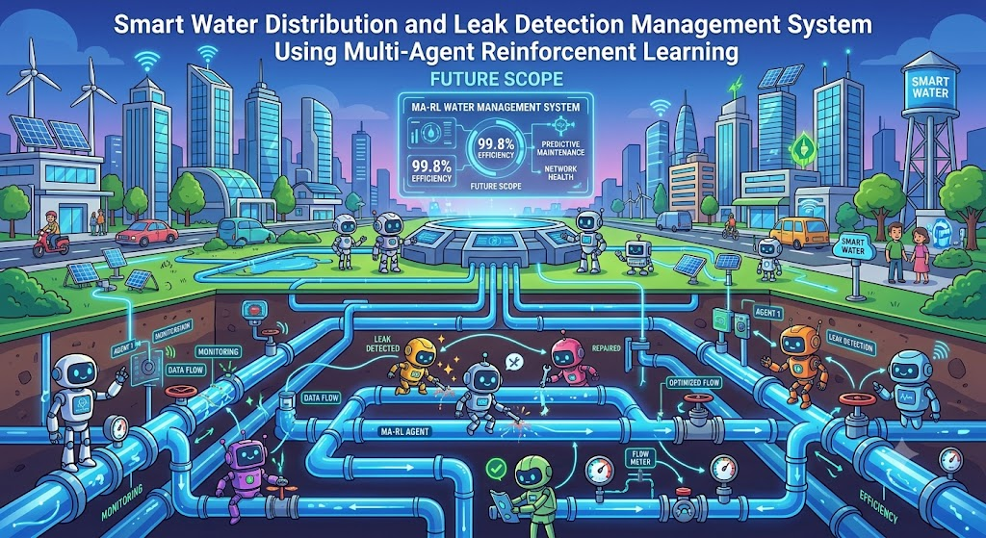
FUTURE SCOPE
Advanced IoT Sensors – Use high-accuracy, low-power sensors for continuous water flow and pressure monitoring.
Cloud and Edge Computing – Enable faster data processing, real-time monitoring, and scalable storage.
Advanced AI/ML Models – Improve early leak prediction and fault detection using deep learning and time-series models.
Scalable Multi-Agent RL – Deploy more intelligent agents to manage large city-wide water distribution networks.
Demand Forecasting – Predict water demand and optimize supply, pressure, and pump operations.

Slide 14
REFERENCES
Javed, A., Wu, W., Sun, Q., & Dai, Z. (2025). Leak Management in Water Distribution Networks Through Deep Reinforcement Learning: A Review. Water, 17(13), 1928.
Taloma, R. J. L., Cuomo, F., Comminiello, D., et al. (2025). Machine Learning for Smart Water Distribution Systems: Exploring Applications, Challenges and Future Perspectives. Artificial Intelligence Review, 58, 120.
Gaurav & Rathi, S. (2025). Machine Learning-Based Leakage Identification in Water Distribution System. Water and Environment Journal. DOI: 10.1111/wej.12970.
Liu, R., Zayed, T., & Xiao, R. (2024). Contrastive Learning Method for Leak Detection in Water Distribution Networks. npj Clean Water, 7, 118.
Tsiami, L., Makropoulos, C., & Savic, D. (2024). Staged Design of Water Distribution Networks: A Reinforcement Learning Approach. Engineering Proceedings, 69(1), 111.
Negm, A., Aggidis, G., & Ma, X. (2024). Water Pressure Optimisation for Leakage Management Using Deep Reinforcement Learning. PhD Thesis, Lancaster University.

Slide 15


